Slide 1
Movie
Making
Merit Badge
Troop 344 and 9344
Pemberville, OH

Slide 2

Requirements
Discuss and demonstrate the proper elements of a good motion picture. In your discussion, include visual storytelling, rhythm, the 180-degree axis rule, camera movement, framing and composition of camera shots, and lens selection.
Do the following:
  In a three- or four-paragraph treatment, tell the story you plan to produce, making sure that the treatment conveys a visual picture.
  Prepare a storyboard for your motion picture (This can be done with rough sketches and stick figures.)

Slide 3
Requirements
Do the following:
  Demonstrate the following motion picture shooting techniques.
    Using a tripod
    Panning a camera
    Framing a shot
    Selecting an angle
    Selecting proper lighting
    Handheld shooting

Slide 4
Requirements
Do the following:
  Using motion picture techniques,, plan ONE of the following programs. Start with a treatment, and complete the requirement by presenting this program to a pack or your troop, patrol, or class.
    Film or videotape a court of honor and show it to an audience.
    Create a short feature of your own design using the techniques you learned.
    Shoot a vignette that could be used to train a new Scout in a Scouting skill.

Slide 5
Requirements
Do ONE of the following:
  With your parent's permission and your counselor's approval, visit a film set or a television production studio and watch how production work is done.
  Explain to your counselor the elements of the zoom lens and three important parts.
Find out about three career opportunities in moviemaking. Pick one and find out about the education, training, and experience required for this profession. Discuss this career with your counselor. Explain why this profession might interest you.

Slide 6
Requirement 1
Discuss and demonstrate the proper elements of a good motion picture. In your discussion, include visual storytelling, rhythm, the 180-degree axis rule, camera movement, framing and composition of camera shots, and lens selection.

Slide 7

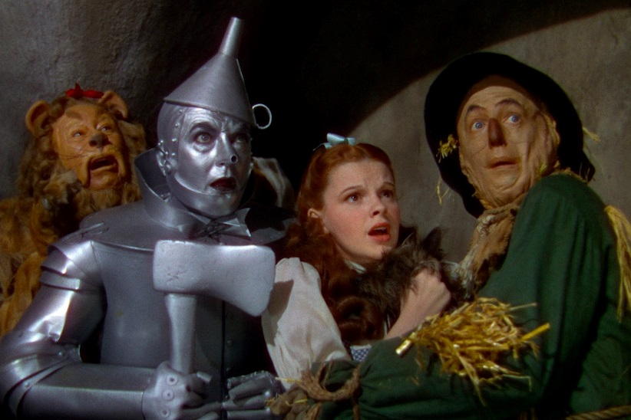
Visual Story Telling
It is said that a picture is worth a 1000 words.
What separates a good movie from a great movie is what the "picture" of the movie says on its own without dialogue or sound.
Take a look at the picture. What does it tell you? What is their emotion? Where is their attention focused?
Even without sound or movement you can tell a lot about the scene and what's going on.
This is the power of Visual Storytelling.

Slide 8
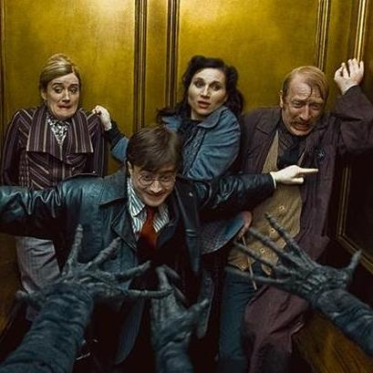
Visual Story Telling
Visual storytelling is about releasing the power of imagery and telling your story as much as possible through the visual elements
The dialogue can then reveal even more of the story.
Beginning movie makers often focus too much on dialogue because they think it's the best or only way to tell a story.
The great movie makers understand that storytelling begins with the images on the screen.
Check out this video that demonstrates visual storytelling.

Slide 9

Rhythm
No matter what the medium, effective storytelling is rhythmic storytelling.
Stories work best when they move through time in a way that is logical, engaging and ultimately satisfying.
To become a rhythmic storyteller, try to answer a number of questions as you develop your story:
  Is there an overall groove? Is this a story that, broadly speaking, moves quickly or at a more leisurely pace?
  Does the story have an overall shape? Is there a general sense of tension and release? For example, the fortunes of the main character could go up and down over the course of the narrative.
  Are events happening at the “right” time?
  Does a certain section last too long or is it too short? Do you feel a need, at certain points, for “something else to happen”?
  Conversely, do you feel that a particular section deserves to be lingered upon a bit longer?
  Does the story feel like it’s flowing, that it’s moving forward like one of your favorite songs?

Slide 10
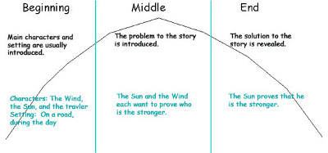
Rhythm
A good story also has an internal rhythm.
You have been taught in school that every story has a beginning, middle, and end.
Keeping these in order is also part of the rhythm.
If you are tying a knot and start with the knot half tied, it will be hard for the viewers to follow.

Slide 11
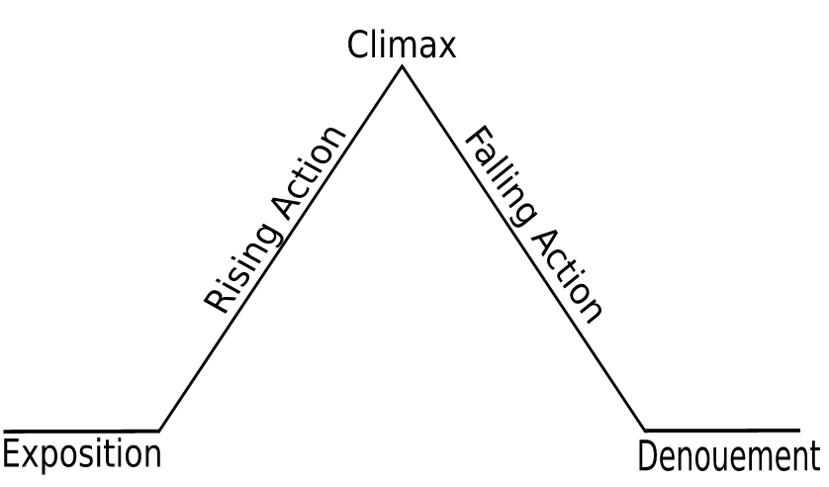
Rhythm
Movies tell stories generally through:
  Exposition – meeting the characters, establishing the setting, setting the tone – establishing the normal of the film world
  Rising Action – the central conflict is introduced and the tension between the protagonist and the antagonist begins to mount
  Climax – The climax is the turning point, which marks a change, for the better or the worse, in the protagonist’s future.
  Falling Action – The major action has happened. This is the aftermath; the sorting out of the major conflict’s resolution.
  Dénouement/Resolution – the creation of the new normal. The conflict is resolved.

Slide 12
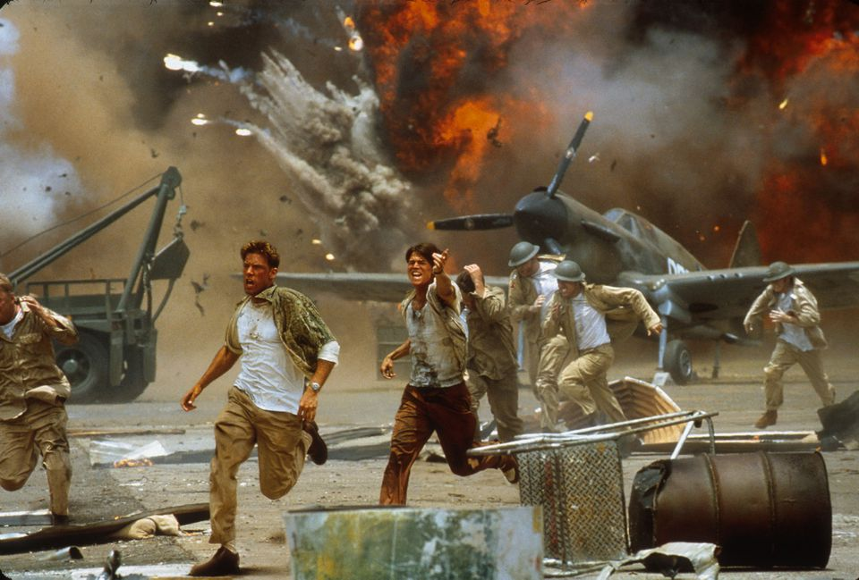
Rhythm
In action movies, the camera angle changes faster during action scenes and slower during the dialogue scenes.
This fast and slow is called rhythm.
The rhythm of the movie helps to tell the story.
Check out this video that demonstrates cinematography rhythm.

Slide 13
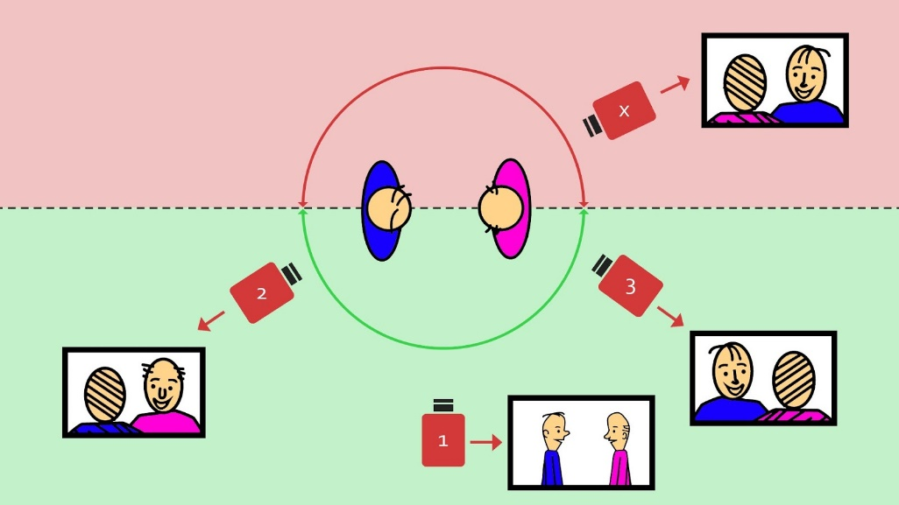
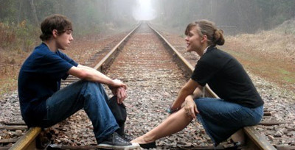

180-Degree Axis Rule
In a scene between two characters, a straight line can be imagined running between the two characters, and extending to infinity.
If the camera remains on one side of this line, the spatial relationship between the two characters will be consistent from shot to shot, even if one of the characters is not on screen.
Shifting to the other side of the characters will reverse the order of the characters from left to right and may disorient the audience.
Check out this video demonstrating the 180-degree axis rule.

Slide 14
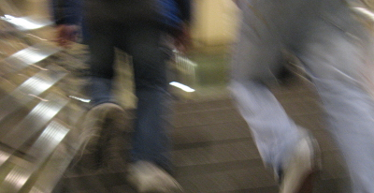
Camera Movement
Most beginning movie makers put their camera on a tripod turn it on and have the actors move in front of it.
Home movies are often wild movement as the camera operator tries to follow the action often making the viewer dizzy.
In both cases the camera person loses the power of camera movement.
Camera movement in feature films is always well planned and helps to tell the story.

Slide 15
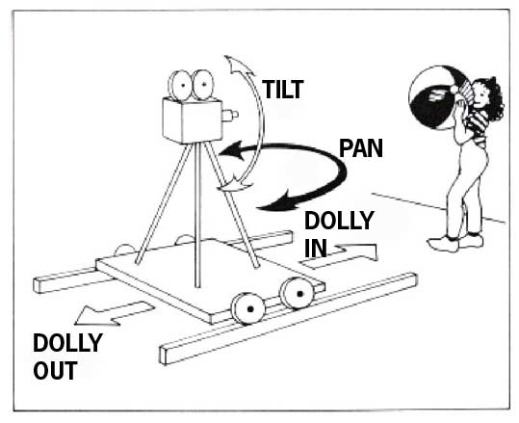
Camera Movement
If you are going to move your camera what are the options?
  Pan: The framing moves left and right, with no vertical movement.
  Tilt: The framing moves up and down, with no horizontal movement.
  Dolly: Moving the whole camera towards or away from the action.
  Zoom: In and out, appearing as if the camera is moving closer to or further away from the subject.
  Follow: Any sort of shot when you are holding the camera, and you follow the action while walking.
Note: Most camera moves are a combination of these basic moves. For example, when you're zooming in, unless your subject is in the exact center of frame, you'll have to pan and/or tilt at the same time to end up where you want to be.

Slide 16
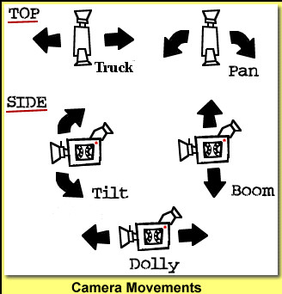
Camera Movement
Watch your favorite TV show.
  TV shows generally leave the camera still and simply pan left and right.
Now watch an action movie.
  Most of the time a movie will dolly (move the whole camera) as they follow a scene.
  This will become apparent if the movie is following one or more people walking, running, or driving.
Explaining the power of camera movement is not as effective as seeing it in action.
Check out this video showing the power of camera movement.
Make sure to use camera movement in your videos.

Slide 17
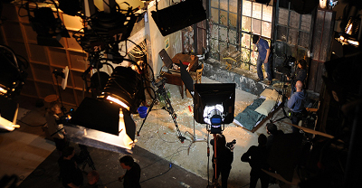
Framing and Composition of Camera Shots
Framing and Composition are about what is and is not in the frame of the camera.
In the picture you can see that there are lots of lights and wires and the back of the wall NOT in the movie.
The audience will only see what the camera sees.
This can be a good thing when you are trying to set a movie in the forest, but are really in your backyard.
The audience can believe the actors are in the forest by having only the bushes and trees in the background.
They won't know that just out of the frame is the corner of the house.

Slide 18
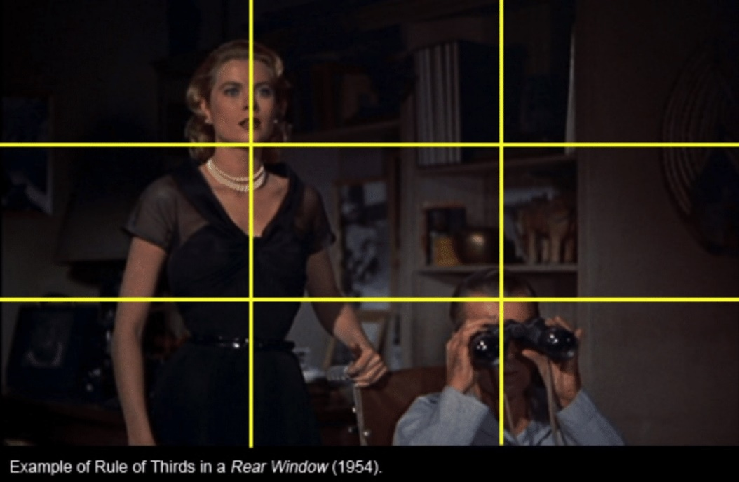
Framing and Composition of Camera Shots
Composition is specifically about how the people or things are arranged on the screen.
The most important rule to follow is called the rule of thirds which divides the frame into nine sections.
  Points (or lines) of interest should occur at 1/3 or 2/3 of the way up (or across) the frame, rather than in the center.
  This gives you four spots on your screen where you can place the person.
  If you have two people/objects, you should try to place both of them onto intersections.
This is the number one rule of good photography and applies to movie making as well.
Check out this video. It does a great job of demonstrating Rule of thirds. (LEGO)

Slide 19


Framing and Composition of Camera Shots
"Headroom", "looking room", and "leading room". These terms refer to the amount of room in the frame which is strategically left empty.
Headroom is the amount of space between the top of the subject's head and the top of the frame.
  A common mistake in amateur video is to have far too much headroom, which doesn't look good and wastes frame space.
The shot of the baby crawling has some leading room for him to crawl into, and the shot of his mother has some looking room for her to look into.
Without this empty space, the framing will look uncomfortable.

Slide 20
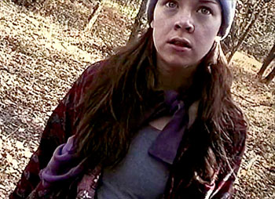
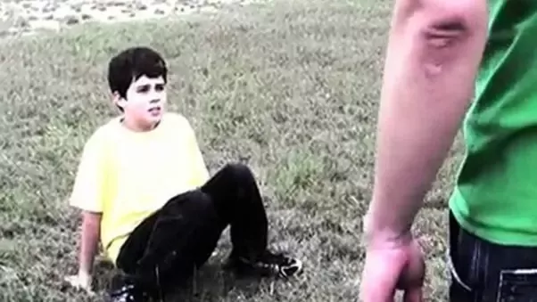
Framing and Composition of Camera Shots
Everything in your frame is important, not just the subject.
What does the background look like? What's the lighting like? Is there anything in the frame which is going to be distracting, or disrupt the continuity of the video?
Pay attention to the edges of your frame.
Avoid having half objects in frame, especially people (showing half of someone's face is very unflattering).
Also try not to cut people of at the joints — the bottom of the frame can cut across a person's stomach, but not their knees. It just doesn't look right.

Slide 21

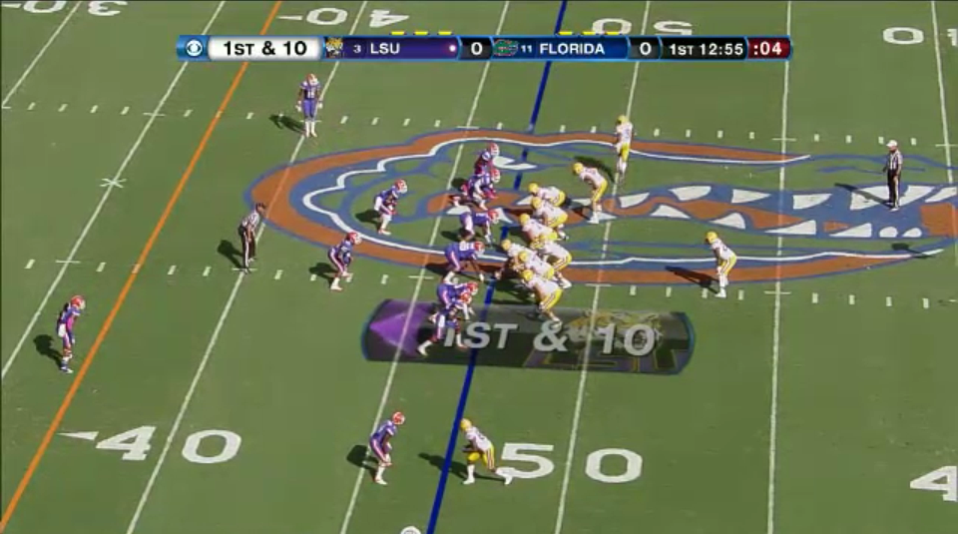
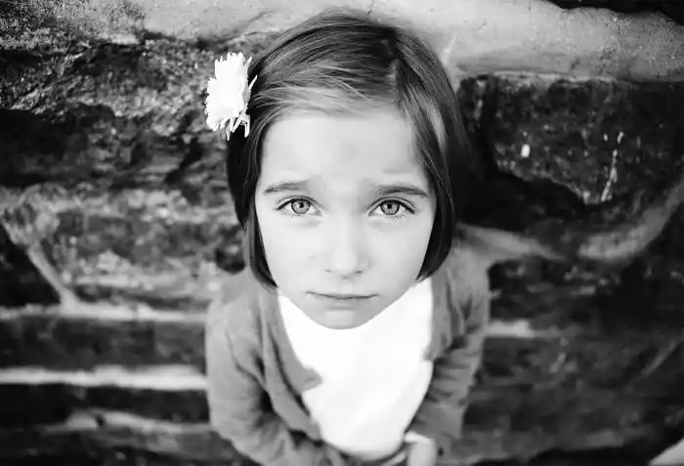
Framing and Composition of Camera Shots
Once you're comfortable with the do's and don'ts, you can become more creative.
Think about the best way to convey the meaning of the shot.
If it's a baby crawling, get down on the floor and see it from a baby's point-of-view (POV).
If it's a football game, maybe you need to get up high to see all the action.

Slide 22
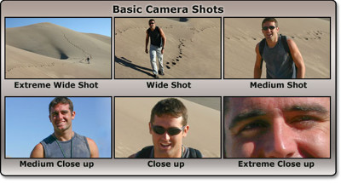
Framing and Composition of Camera Shots
Basic Camera Shot types:
  Extreme Wide Shots (EWS) act to establish the area.
  Wide Shots (WS) show the entire person or area. They’re great for establishing the scene and allow for good action of the characters. Sometimes this is known as the long shot.
  Medium Shots (MS) frame the subject from the waist up. This is the most common shot and allows for hand gestures and motion.
  Medium Close Ups (MCU) shots show the subject in more detail and are often framed from just below the shoulders to the top of the head.
  Close Ups (CU) show a particular part of your subject. For people this usually means the shot frames just the head!
  Extreme Close Ups (ECU) are much tighter close-up shots in which you get detail greater than the human eye might be able to normally perceive. An example of this shot might be of the mouth and eyes together

Slide 23
Framing and Composition of Camera Shots
Framing and composition are important in telling a story.
Each of the six choices tell us what is important in the scene.
  Wide - the desert is the main object, the person is lost within it.
  As you move closer the man himself becomes more important.
  A close-up tells the audience that what he is saying is important.
  An extreme close-up says that what he is thinking is most important.
Check out this video demonstrating Framing and Composition of Camera Shots

Slide 24
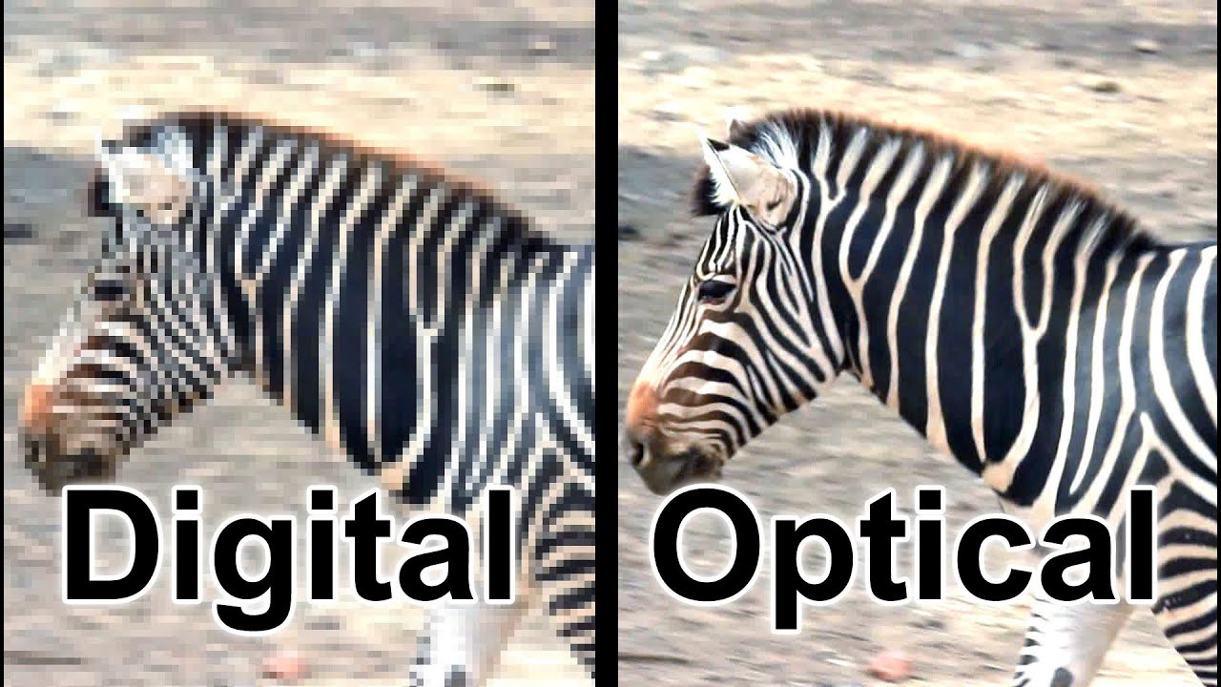
Lens Selection
Cameras capable of using different lenses are very expensive and beyond the price range of most beginning movie makers.
Lens selection becomes a matter of selecting different devices to make your video such as phones or iPads which have what is called a Prime Lens.
Prime lenses are fixed and can only use digital zoom, not optical zoom.
A digital zoom actually distorts the image when you enlarge it more and more grainy.
You can't see this effect on the small screen on your device, but if you watch your video on a large TV, a digital zoom will make the picture blurry.
This is a major disadvantage to using phones and iPads.

Slide 25
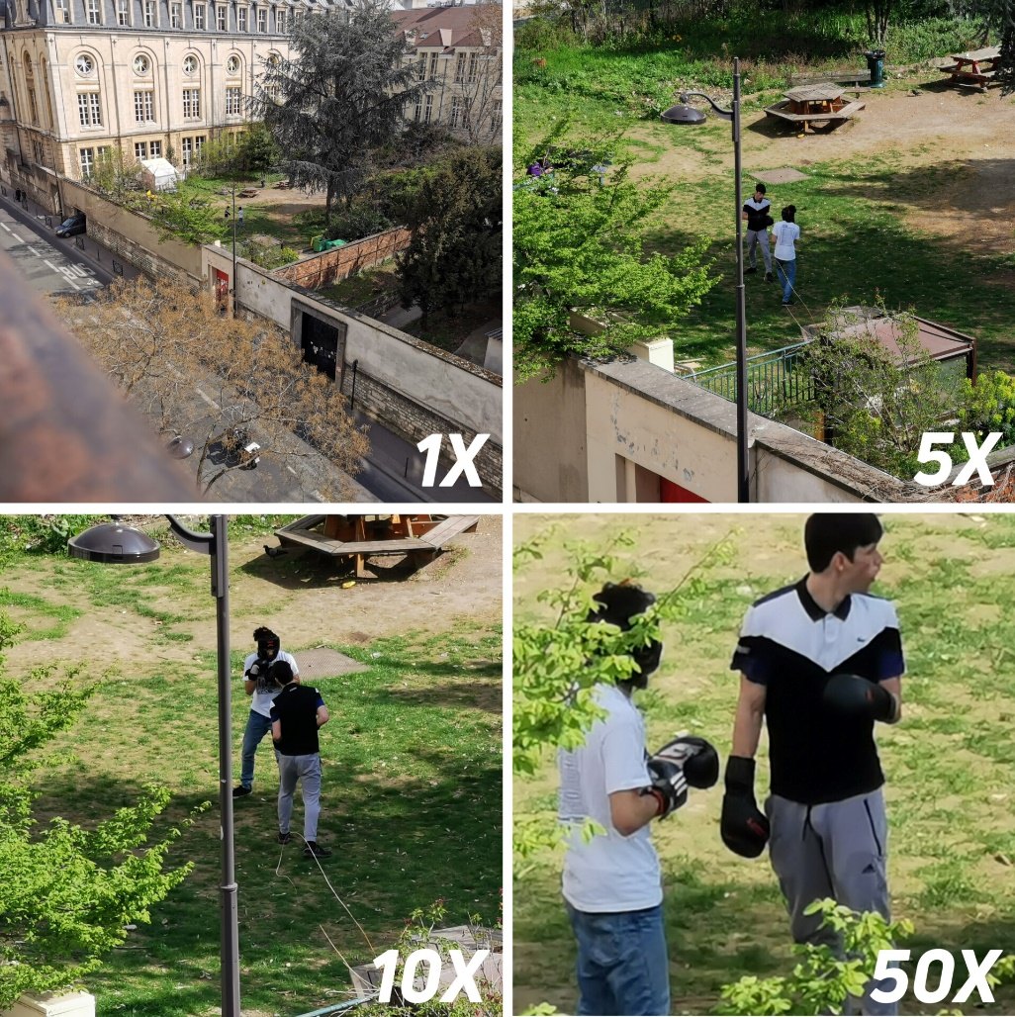
Lens Selection
Using a camera with an optical zoom lens is preferable.
Optical zoom does NOT distort the picture, so the picture will look good even on a large TV.
If you decide to buy a video camera you should look for it's optical zoom range.
The general range is 10x or 20x.
  This means the optical zoom can make the image 10 times or 20 times larger than the normal setting.
You should only use the digital zoom when there is no other choice.
Remember, enlarging a photo or video on your computer later is using a digital zoom.

Slide 26
Requirement 2
Do the following:
  In a three- or four-paragraph treatment, tell the story you plan to produce, making sure that the treatment conveys a visual picture.

Slide 27
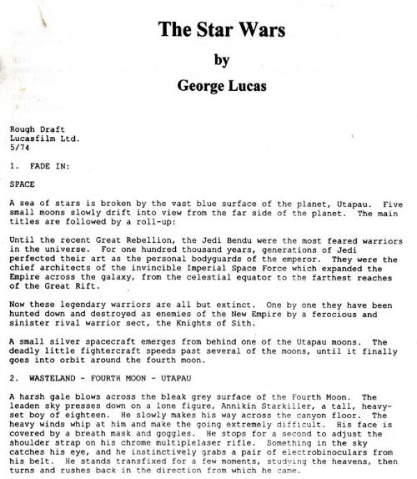
Write a Treatment
A good movie tells a story; the better the story the better the movie.
The first step in making a movie is a Writing a Treatment.
A Treatment is a written document which reads like a short story of your movie with emphasis on what the audience will see.
On the left is the treatment that George Lucas wrote before he made the movie Star Wars.
Notice that there are differences from the actual movie.
It's OK to vary from the Treatment along the way, but you have to start with a story if you are going to end with a story.

Slide 28
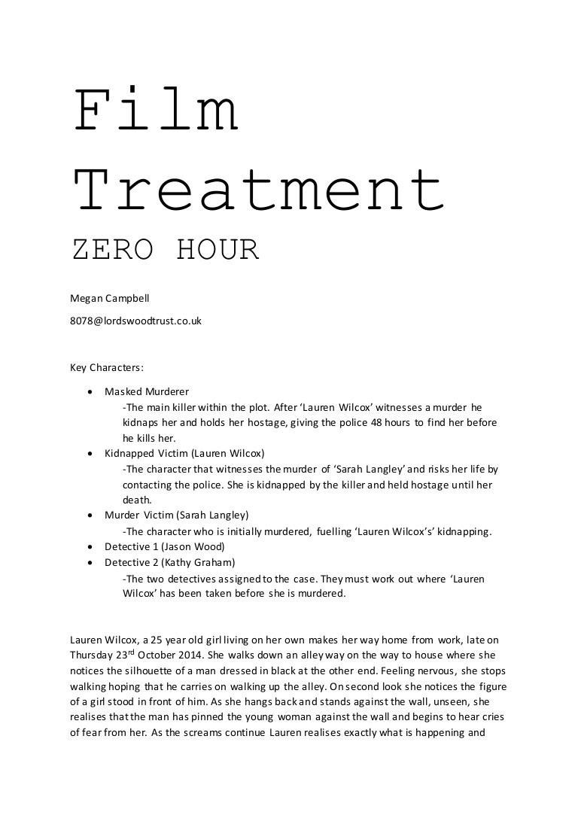
Write a Treatment
The Treatment for “The Star Wars” was 34 pages long.
This requirement asks for 3 to 4 paragraphs.
List the key characters with necessary information that influences the story.
Your story needs a beginning, middle, and end.
In a Treatment, what the audience will see is the most important part.
Developing a detailed Treatment before you start will save a lot of time during filming.
A Treatment will help you remember to get the shots you want.
It is common, after filming, to think, "I wish I had filmed ______."

Slide 29
Requirement 2
Do the following:
  Prepare a storyboard for your motion picture (This can be done with rough sketches and stick figures.)

Slide 30
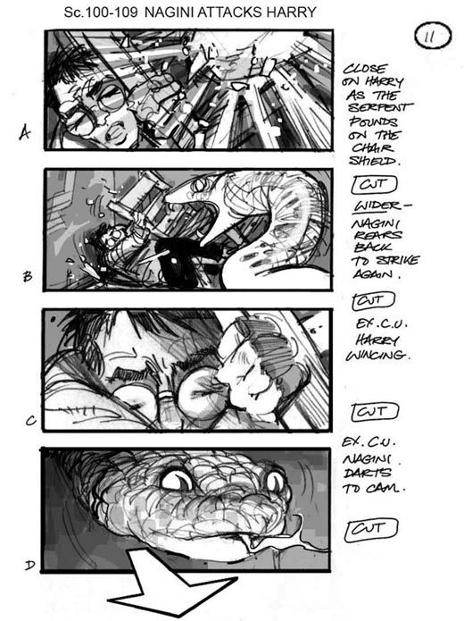
Prepare a Storyboard
Just like a treatment, professionals will often make a storyboard as part of the preparation for their movie.
A storyboard is a scene by scene or camera angle by camera angle visual representation of the movie.
The storyboard is often a series of individual pictures on separate pieces of paper.
Having them on separate pieces of paper can help a director decide to rearrange them to help tell the story better.

Slide 31
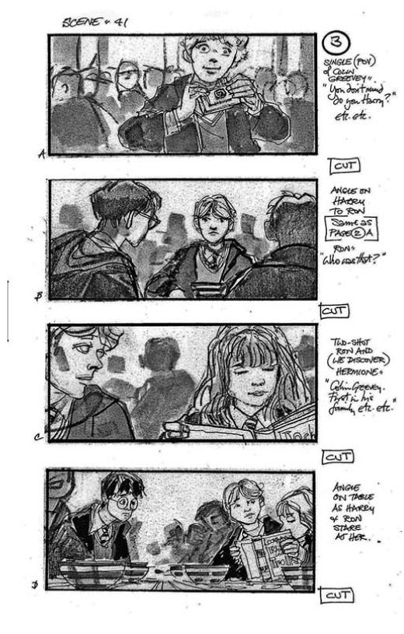
Prepare a Storyboard
The storyboard helps in 2 ways.
  First, it will help you think about 'blocking.'
    Blocking is a theater term of where the actors will stand and where the camera will be placed.
    These will help save time setting everything up when you actually make your movie.
  Second, it will allow you to see visually how the movie will go.

Slide 32
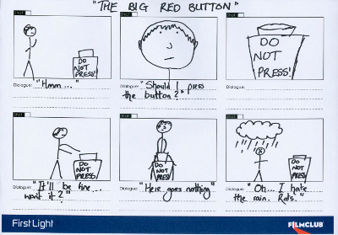
Prepare a Storyboard
Stick figures will work just fine to accomplish what you need in a Storyboard.
In this example some of the dialogue is included.
Having dialogue, or snippets of dialogue, will help you keep track of what is going on in each scene.
Storyboards are a tool for your use.
Feel free to design it in a way that works best for you.

Slide 33
Requirement 2
Do the following:
  Demonstrate the following motion picture shooting techniques.
    Using a tripod
    Panning a camera
    Framing a shot
    Selecting an angle
    Selecting proper lighting
    Handheld shooting

Slide 34
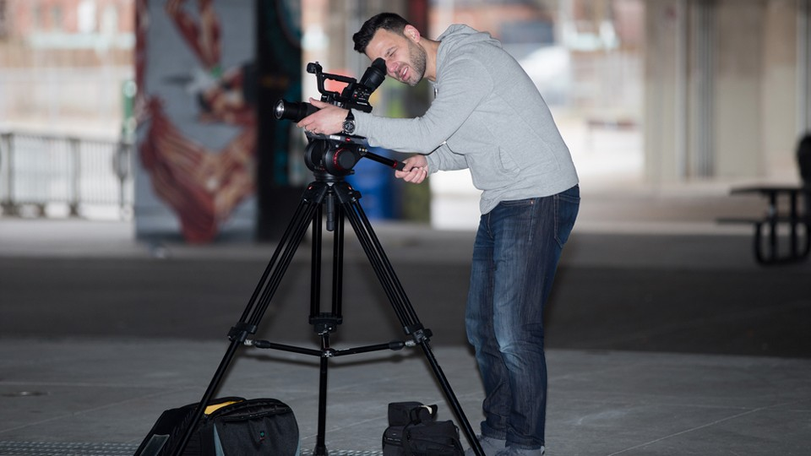
Using a Tripod
When people hold their camera by hand to make a movie, it's hard to hold them steady resulting in shaky shots.
  Sometimes a shaky shot can add tension to the story.
  Generally, you want the camera to remain still so that the audience can focus on the action of the actors instead of being distracted.
A tripod will reduce camera movement and improve picture quality
When using a tripod, make sure you understand and do the following:
  Set up your tripod correctly.
  The legs of the tripod should be on a solid ground so they won't move accidentally.
  If the ground is slanted you may have to adjust one or two of the legs to level the tripod.
  Make sure the camera is attached to tripod securely and properly.

Slide 35
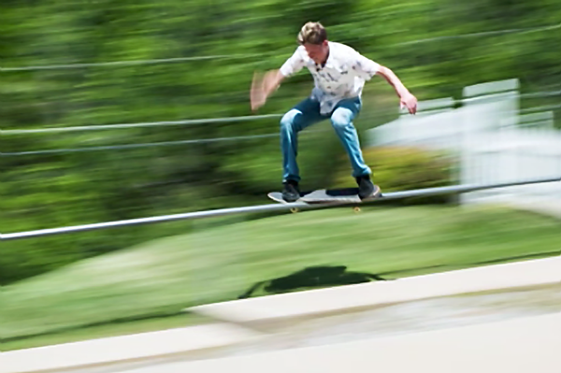
Panning a Camera
In cinematography panning means swiveling a video camera horizontally from a fixed position.
This motion is similar to the motion of a person when they turn their head on their neck from left to right.

Slide 36



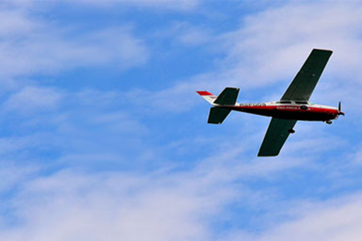
Panning a Camera
The “rule of lead room” when panning the camera is that when framing a subject, well composed shots will include space in the direction that a subject is facing, or in the case of moving objects, in front of the direction that an object is moving.
In the portrait, lead room has been given in the direction the model's body is facing and as a result the portrait feels open and relaxed.
If we take the same exact picture and shift the model to the other side of the frame, all of a sudden it feels as though the model is cramped within the frame.
The effects of lead room can be even more pronounced when the subject of a photograph is in motion. In the image of the airplane there is a sense of moving through the frame from left to right because it appears that it has room to move.

Slide 37
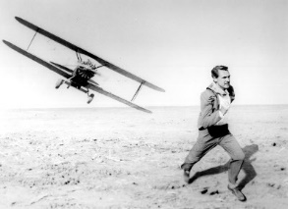
Framing a Shot
You must be able to demonstrate that you know how to frame a shot.
As you make your movie, it is easy to forget what you learned about framing and composition.
If you want people to concentrate on the story – not the filmmaking – you should frame your shot to look natural.
Study the section on Framing and Composition and then practice, so that it becomes second nature.

Slide 38
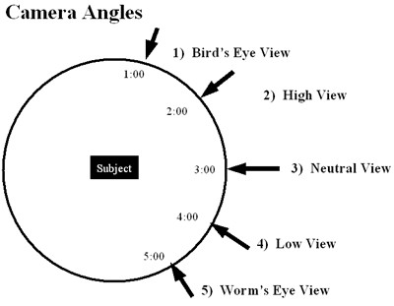
Selecting an Angle
A variety of camera angles can add power to your movie.
The best way to learn about camera angles is to watch major motion pictures with the sound off.
Pay attention to the height and tilt of the camera in each scene.

Slide 39
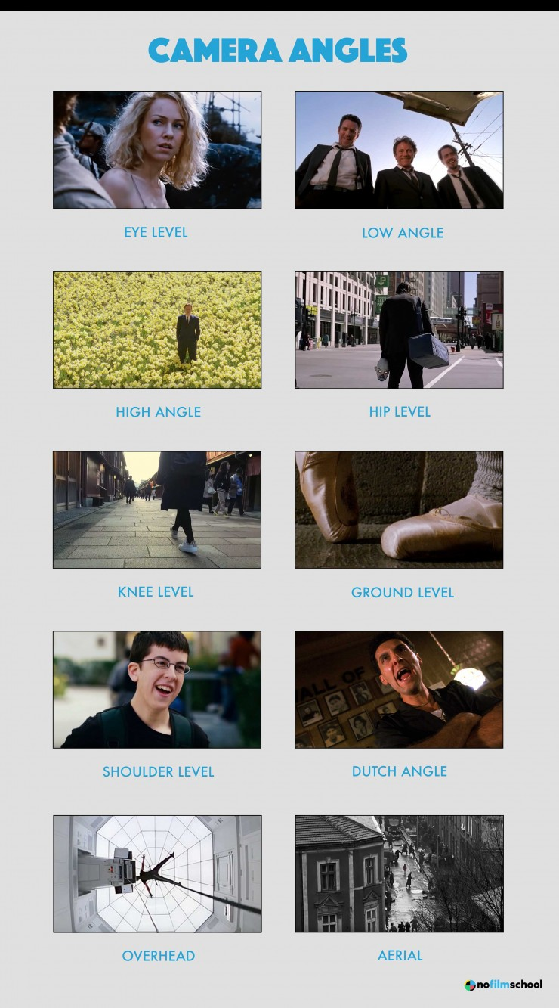
Selecting an Angle
An eye level shot can result in a neutral perspective (not superior or inferior).
Low angle shots are for signaling superiority or to elicit feelings of fear and dread.
High angle shots usually creates a feeling of inferiority, or “looking down” on your subject.
Hip level shots are often useful when one subject is seated while the other stands.
Knee level shots can emphasize a character’s superiority if paired with a low angle.
A ground level shot is used to feature a character walking without revealing their face.
Shoulder level shots can make your actor seem shorter than reality.
For a Dutch angle shot the camera is slanted to one side creating a sense of disorientation.
Overhead or Bird’s Eye shots is used for isolating subjects.
Aerial Shots establish a large expanse of scenery.

Slide 40
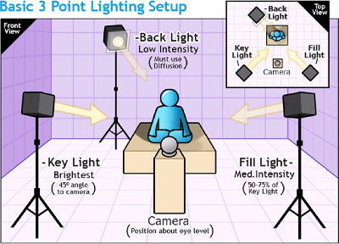
Selecting Proper Lighting
Use front lighting which means that the lighting should be in the face of the actors.
  If you are outside place the sun behind the camera so that the sunlight reflect off of the actors faces and into the camera.
  If inside, place the actors so the light in the room is above and in front of them.
  Lighting straight down or off to the side will create shadows on their faces.
  The camera is not as good as your eye when looking at shadows and they will appear much darker.
  The camera will often adjust to a bright light or window behind an actor resulting in the actor being very dark or even completely black in silhouette.
3-point lighting is the standard; two lights in front and above and one light above and behind the actor will give a professional look to your video.

Slide 41
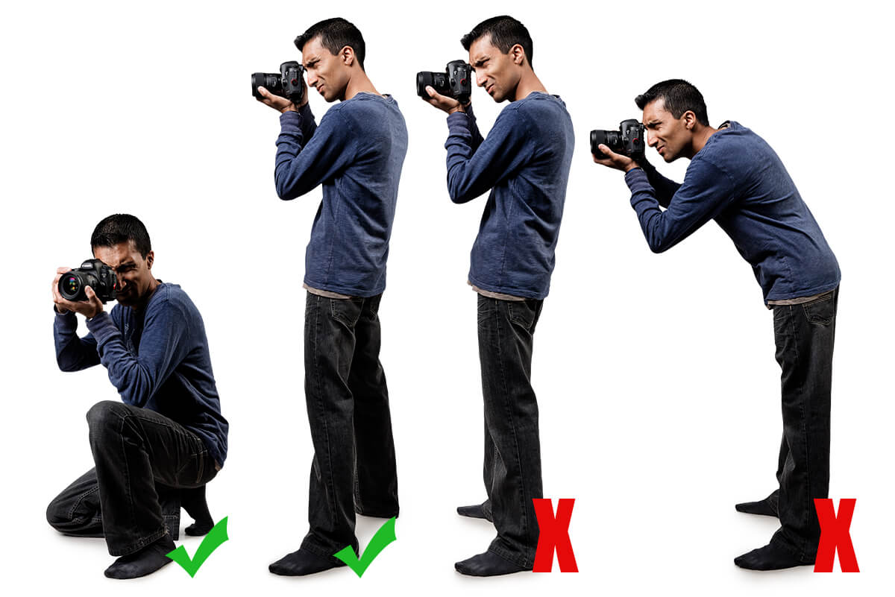
Handheld Shooting
Sometimes you need to take the camera off the tripod and hold it in your hands.
The picture shows both correct and incorrect ways to hold your camera steady.
Correct:
  Notice that his elbows are in tight to his body.
  This will allow you to hold the camera steady for a much long time.
  You can also try leaning against a wall or resting your elbows on a knee or other object.
  Before you press the record button make sure you are ready to hold your camera for the whole shot.
Incorrect:
  If standing with your feet in line you need to move, you will either have to lean or step forward, causing shake in the camera.
  If you are bent over, as the right stance shows, you will be unbalanced making it difficult to keep steady.

Slide 42
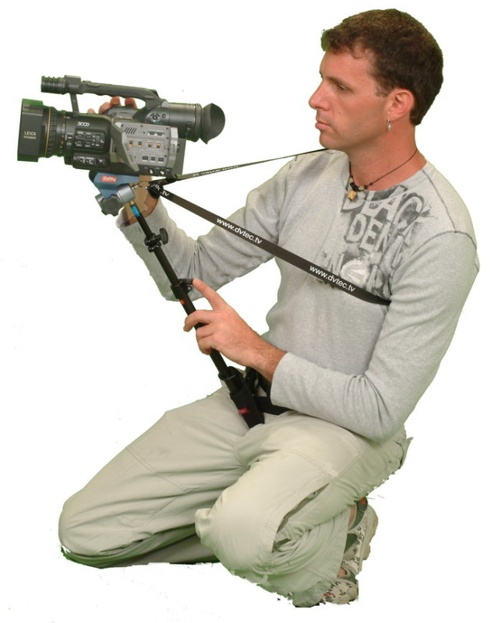
Handheld Shooting
Another option is to obtain a support for your camera.
These devices like the one in the photo will balance your camera and help keep it steady while filming.

Slide 43
Requirement 2
Do the following:
  Using motion picture techniques,, plan ONE of the following programs. Start with a treatment, and complete the requirement by presenting this program to a pack or your troop, patrol, or class.
    Film or videotape a court of honor and show it to an audience.
    Create a short feature of your own design using the techniques you learned.
    Shoot a vignette that could be used to train a new Scout in a Scouting skill.

Slide 44
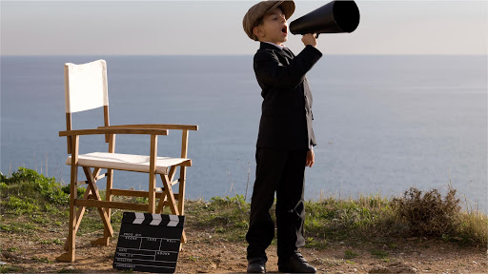
Make a Movie
It's time to make your movie.
Take the design in your head and make it into a movie for others to enjoy.
Use your Treatment, but keep in mind that your Treatment does not have to be exactly what your final project turns out to be.
Your Storyboard will help streamline the filming process by establishing the scenes, framing and composition, and camera angles before you start.
You do not have to star in your movie; the reality is that it will be easier to make a movie if you are not in it.
Use the techniques you have learned.
Be creative and try new things.
Plan extensively BEFORE you start.

Slide 45
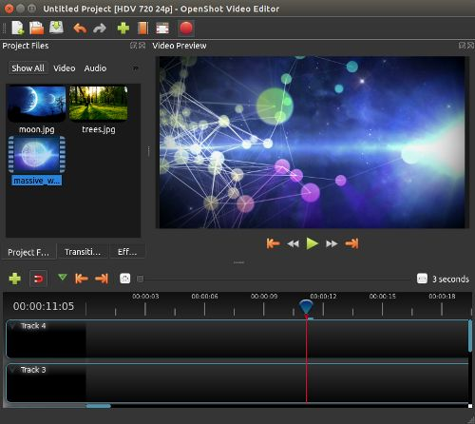
Editing
Using a video editor will allow you to put together various shots in any order you please to create your film.
Desktop video editors typically have more editing power than mobile apps.
The following desktop video editing software is free and relatively easy to learn.
  OpenShot
  VSDC Free Video Editor
  Movie Maker 10 for Windows
  iMovie available for Mac

Slide 46
Requirement 3
Do ONE of the following:
  With your parent's permission and your counselor's approval, visit a film set or a television production studio and watch how production work is done.
  Explain to your counselor the elements of the zoom lens and three important parts.

Slide 47
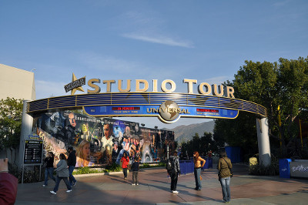
Visit a Film or Television Studio
Hollywood studios offer regular tours.
Contact your local TV stations to see what opportunities for a tour might be available to you or your Scout troop.

Slide 48
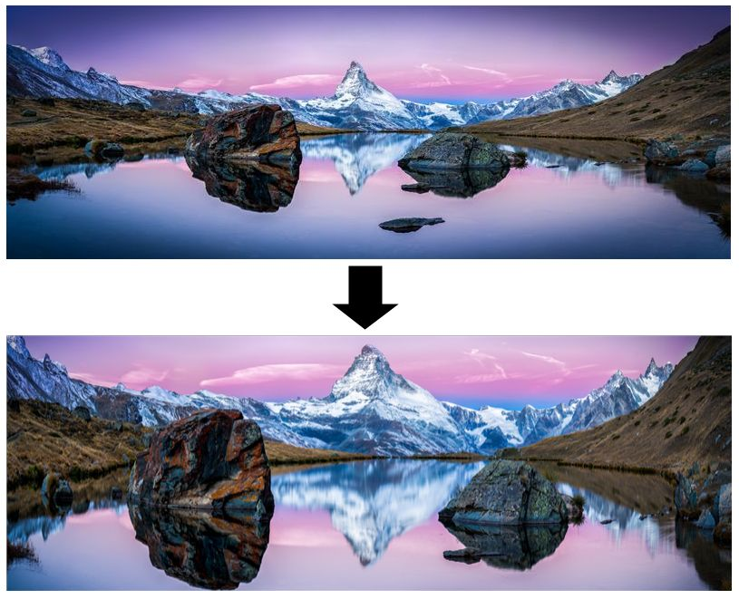
The Zoom Lens
A zoom lens is a type of camera lens that offers a useful range of different focal lengths in a single lens by manipulating various lenses to change the camera's focal length.
A zoom lens allows for quick and easy re-framing of a scene while staying in the same physical position.

Slide 49
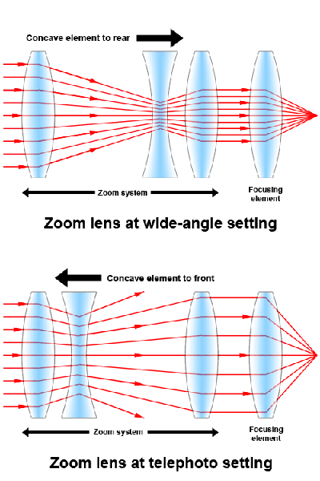
The Zoom Lens
Three parts of a zoom lens:
The first part of a zoom lens is the moveable concave element which regulate the amount of light rays that make it into the camera. In the top picture a wide amount of the light rays make it into the camera (zoomed out). In the lower picture only the center rays make it into the camera (zoomed in).
The second part of the zoom lens is the focus element. When you simply enlarge the center of a picture you expect it to get fuzzy. The focus element brings the picture into focus even when zoomed in. This gives the impression that the objects are closer.

Slide 50
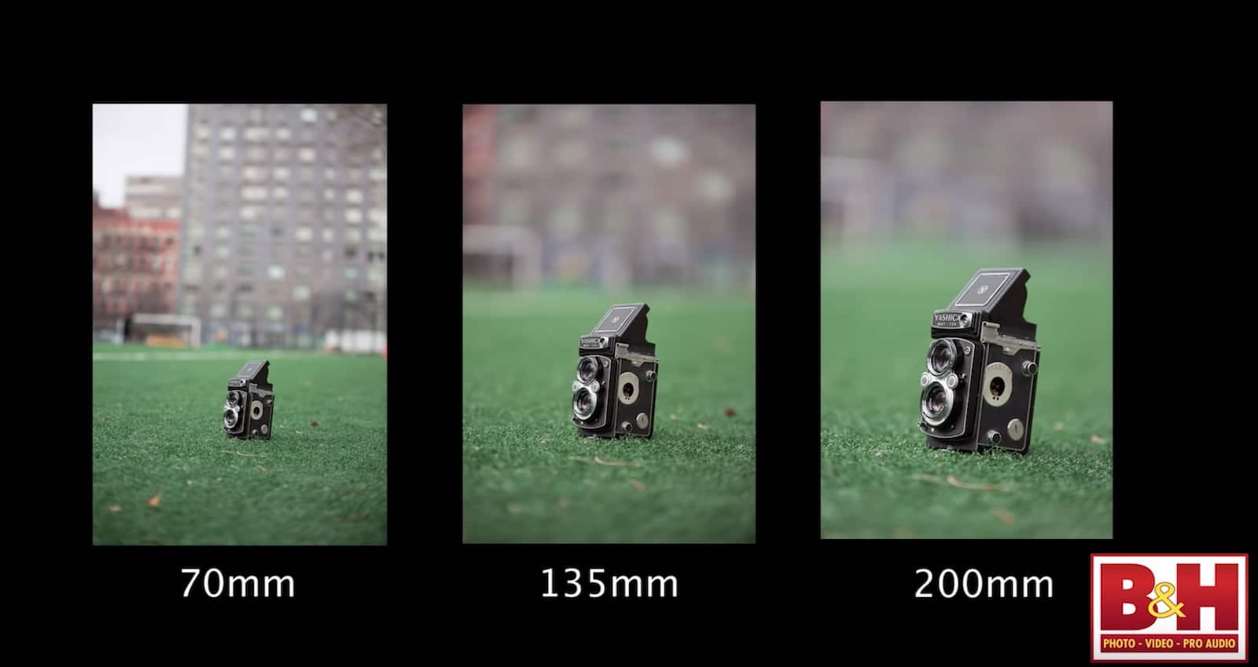
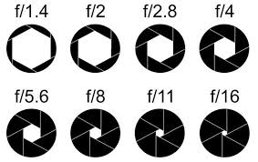
The Zoom Lens
Three Parts of a Zoom Lens:
The third part of a zoom lens is the aperture. The aperture is an adjustable iris, which can make a different size hole affecting the depth of field. Depth of field is the distance between the closest and farthest objects in a photo that appears acceptably sharp. When you zoom way in, the aperture opens up and the depth of field gets very small. In other words, the larger the aperture the fewer things are in focus.

Slide 51
Requirement 4
Find out about three career opportunities in moviemaking. Pick one and find out about the education, training, and experience required for this profession. Discuss this career with your counselor. Explain why this profession might interest you.

Slide 52
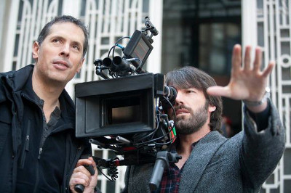
Career Opportunities in Moviemaking
There are many careers in moviemaking. From Directing to Craft Services (Catering), hundreds sometimes thousands of people are involved in making a single film. A simple google search will provide you with a number of careers. Below is just a short list of all the many different career options.
Producer
  This person is hired by a studio to help manage every aspect of a television show or film. The executive producer is the highest level of producer on a given show.
Director
  The director is the head of the production unit and is responsible for directing the actors and for translating the script into cinematic images in accordance with their own vision.
Art Director
  Designs and oversees set construction.

Slide 53
Career Opportunities in Moviemaking
There are many careers in movie making. From Directing to Craft Services (Catering), hundreds sometimes thousands of people are involved in making a single film. A simple google search will provide you with a number of careers. Below is just a short list of all the many different career options.
Cinematographer / Director of Photography
  Carries out the director’s vision for the look of a film. Plans and supervises others to achieve the right camera shots, lighting and set design.
Key Grip
  The head grip in charge of setting up equipment to enable the camera crew to capture the right shots.
Gaffer
  Sets up the lighting on set.

